Slide 1
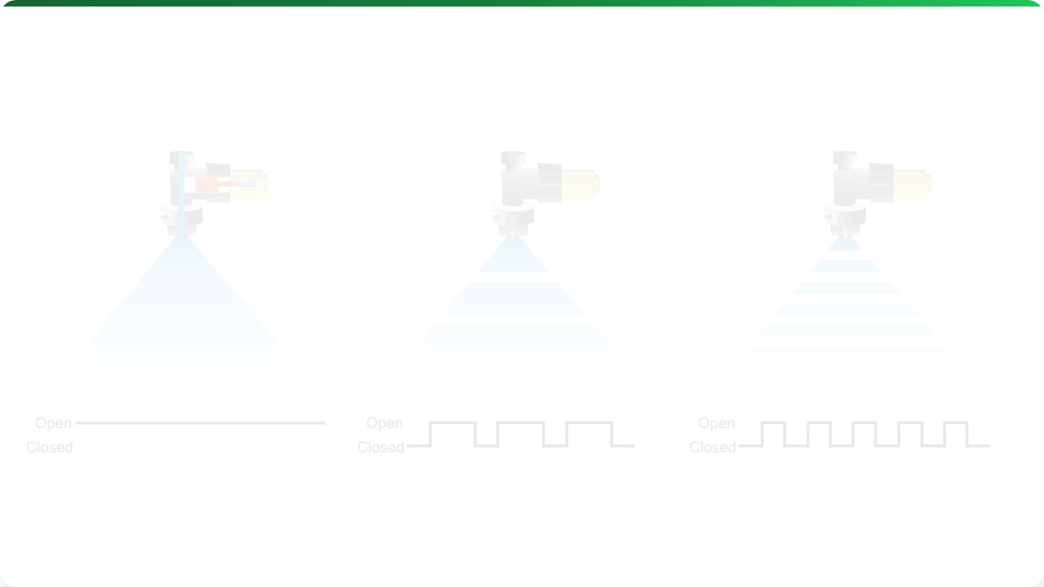



CONTROL SYSTEMS & VRT
Lecture 8: The Mechanics of Precision
AGE 418
Dr. Kadeghe Fue

Slide 2




Lecture Roadmap
Control Theory
VRT Systems
The Feedback Loop
ISOBUS Electronics
Open vs. Closed Loop
Map-Based vs. Sensor-Based
Components (Sensor, ECU, Actuator)
Mechanics (Hydraulic, Electric, PWM)

Slide 3
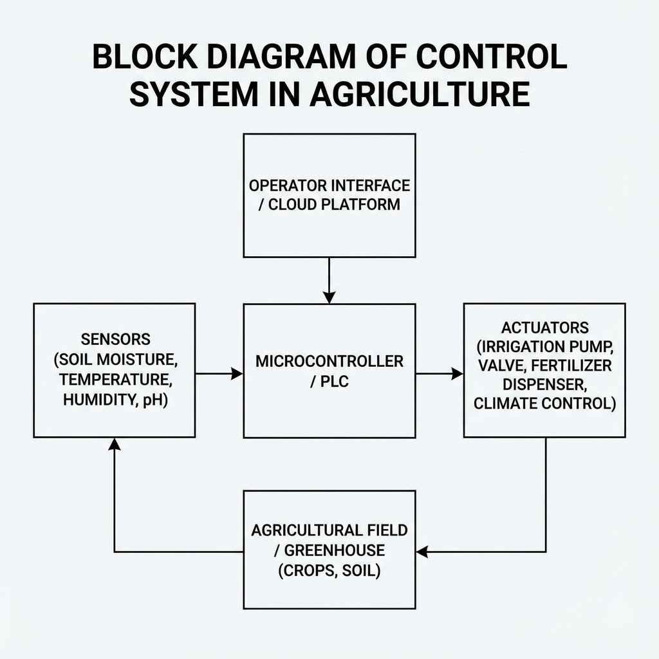

What is a Control System?
Definition: A device or set of devices that manages, commands, directs, or regulates the behavior of other devices or systems.
In Agriculture, it answers:
"How do I ensure the tractor sprays exactly 200 Liters/Hectare, regardless of speed?"

Slide 4


The Loop Concept
Open Loop
No feedback. You set it and hope.
Ex: A simple fan speed dial.
Closed Loop
Has Feedback. It checks the output and adjusts.
Ex: Cruise Control (Maintains speed uphill).

Slide 5

PID Control Logic
How the computer drives like a human.
Proportional
Integral
Derivative
"The Present"
"The Past"
"The Future"
Big error = Big correction. (Steering hard into a turn).
Fixes small, accumulated errors (Drift).
Predicts error trend to prevent overshooting.

Slide 6





Hardware Components
Sensor
Controller
Actuator
Measures the Reality.
(Flow meter, Speed radar).
The Brain (ECU).
Compares Reality vs Target.
The Muscle.
(Hydraulic valve, Electric motor).

Slide 7


The Old Problem: Incompatibility
Before 2000, every manufacturer had different plugs.
John Deere tractor couldn't talk to a Case IH planter.
The "Monitor Clutter"
Cab was full of 5 different monitors.
Wiring was a nightmare.

Slide 8
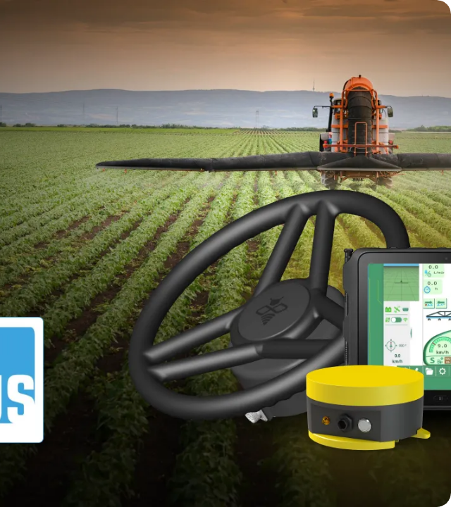
The Solution: ISOBUS
ISO 11783 Standard
The "USB" of Agriculture. One cable, one language.
Plug & Play: Any tractor, any implement.
Universal Terminal (UT): One screen controls everything.

Slide 9


Variable Rate Technology (VRT)
Applying the Right Rate to the Right Zone automatically.
Map-Based
Sensor-Based
Pre-planned prescription.
Real-time reaction.

Slide 10
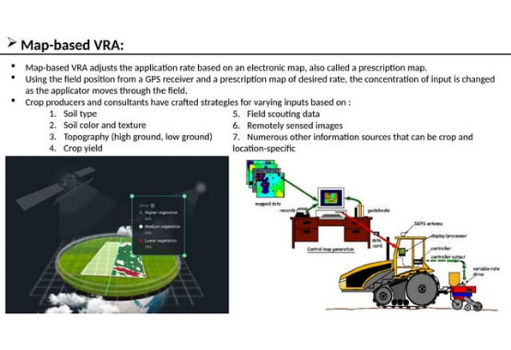
Map-Based VRT
The Workflow:
1.
Collect Data (Yield, Soil Test).
2.
Create Zones (GIS Software).
3.
Assign Rates (Prescription).
4.
Upload to Tractor Computer.
5.
GPS matches tractor position to map zone.

Slide 11

Sensor-Based VRT
"Measure and Apply"
No map needed. The system scans the crop and treats it instantly.
Example: GreenSeeker sensing biomass and applying Nitrogen.
Benefit: No data processing time.
Drawback: Reactive only (doesn't know soil history).

Slide 12

Mechanics: Liquid (Sprayers)
How do we change flow rate?
Method 1: Pressure
Method 2: Speed
Method 3: PWM
Change pump pressure.
Drive faster/slower.
Pulse Width Modulation.
Problem: Changes droplet size (Drift risk).
Problem: Practical limits.
The Gold Standard.

Slide 13
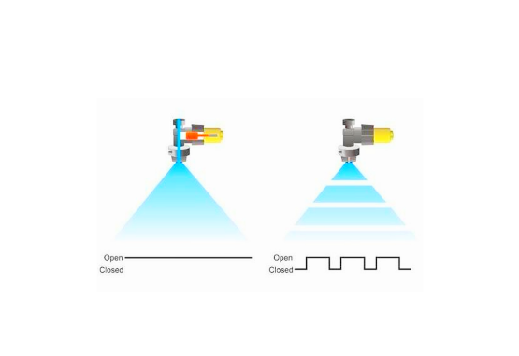


Pulse Width Modulation (PWM)
An electric solenoid turns the nozzle ON and OFF 10 times per second (10Hz).
50% Duty Cycle = Half Flow Rate, but Pressure stays constant.

Slide 14
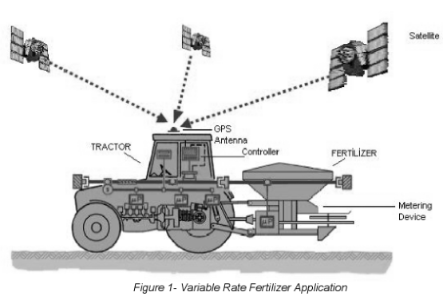
Mechanics: Granular (Fertilizer)
For solid fertilizer spreaders (Spinners):
Gate Height: Actuator opens/closes the rear gate to let more/less material out.
Belt Speed: Hydraulic motor speeds up the conveyor belt to deliver more material.

Slide 15
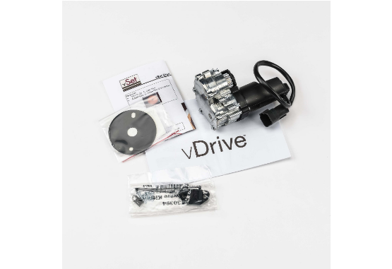
Mechanics: Seeding (Planters)
Controlling population (seeds/acre).
Hydraulic Drive: One motor turns the seed shaft for the whole planter (or sections).
Electric Drive: Individual electric motor on every seed meter. Ultimate precision.

Slide 16
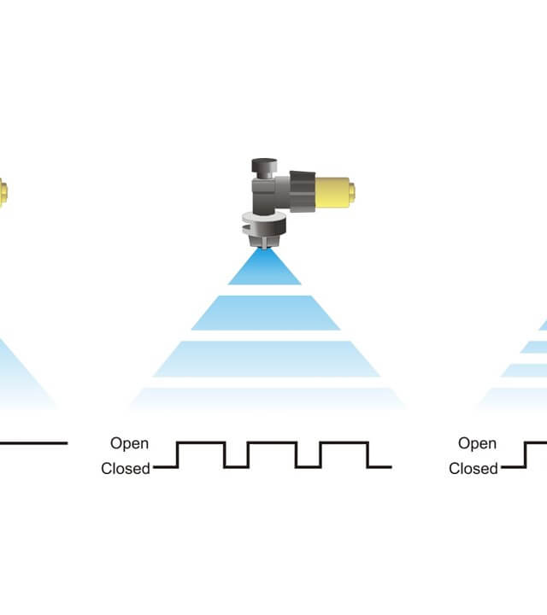
Automatic Section Control
"Auto-Swath"
Uses GPS to detect if an area has already been covered.
Automatically shuts off individual boom sections or planter rows.
Benefit: Eliminates overlap in headlands and point rows.
Savings: 5-15% on seed/chemical costs.

Slide 17

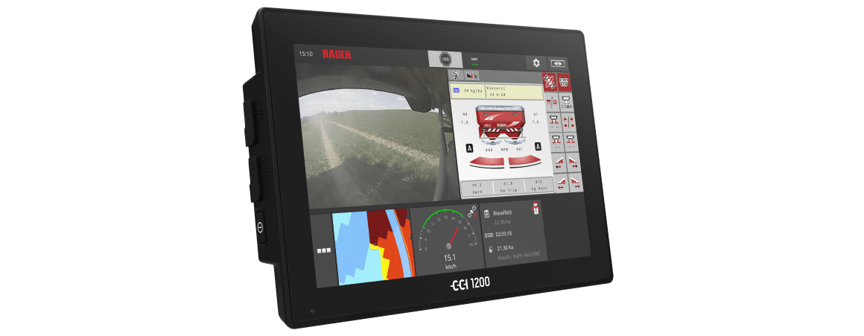
The User Interface (VT)
The Virtual Terminal inside the cab.
One screen to control guidance, planting, and application.

Slide 18

Lecture Summary
Control
Electronics
VRT
Closed-loop systems use feedback to maintain accuracy. PID logic prevents errors.
ISOBUS is the standard that allows tractors and implements to communicate.
Can be Map-Based or Sensor-Based. Executed via PWM (Liquids) or Motor Speed (Solids).
Next Class: Lecture 9 - Yield Monitoring

Slide 19

Questions?
Dr. Kadeghe Fue | AGE 418
Sokoine University of Agriculture

